Slide 1


Maximizing Your Role as a Teen Influencer:
What You Can Do To Help Prevent Teen Prescription Drug Abuse
Updated October 2015

Slide 2
Workshop Overview
Welcome and Introductions (10 minutes)
Presentation (25-30 minutes)
It’s Your Turn (15 minutes)
Wrap Up and Evaluation (10 minutes)
Notes:
Good morning/good afternoon/good evening everyone. Thank you for taking time out of your busy schedule to be part of this discussion.
The misuse of prescription drugs by teens is a public health problem that places many teenagers at serious risk. Whether you’re a parent, teacher, coach, school administrator, a community or school-based health provider, you need to be aware of teens abusing or feeling pressure to abuse prescription drugs. These medications arethe same ones we keep in our medicine or kitchen cabinets.
My name is _________________________, and I will be leading today’s workshop.
[Give brief information about how you became involved (are you a parent, educator, health professional?), and why you think this is such an important issue; for example, if you know a family that has struggled with prescription drug abuse or if you are passionate about doing something to make sure this issue is addressed in your community.].
I’d like to have this be an informal workshop, so please feel free to ask questions or raise concerns as we go along.
[Add any details about where the restrooms are located, explanation of the index cards if you decided to use them to collect questions; Talk about setting a few ground rules for the group – if someone shares personal story, it’s understood that this information should be kept confidential, being respectful of others, not interrupting, etc.]
As you can see, I’ll run through the slides to give you some background on the issue. Then we’ll break into pairs or small groups for a role play activity, and reconvene to discuss how you might handle some of these real-life scenarios. I’ll also review the program materials and other helpful resources that we hope you will use and refer to after this workshop. Lastly, I’ll ask you to fill out the evaluation form.

Slide 3

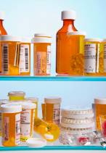

Today’s Goals
Learn about prescription (Rx) drug abuse.
Dispel common myths.
Reinforce your position as a role model.
Provide tips for communicating with teens.
Empower you to take an active role to reduce Rx abuse.
Notes:
The main goal of this workshop is to help teen influencers--parents, grandparents, teachers, coaches, school nurses and resource officers, or community-based health professionals--understand the risk of prescription drug abuse among teens and how you can take action to help lower that risk.
I’ll start by giving a brief overview of this troubling teen health problem—the extent of the problem, what motivates teens to misuse or abuse prescription drugs, how they access these drugs, which ones are commonly abused, as well as possible red flags indicating that a teen might have a problem.
Next, we’ll tackle some common myths.
We’ll review the powerful role you can play in educating teens about the dangers of prescription drug abuse and helping to promote healthy alternatives.
Finally, I hope each of you will help carry today’s message forward, whether it's raising the subject with the teens you interact with, helping to implement drug-free activities within your schools or communities, and/or engaging other teen influencers by sharing these materials or offering to give this workshop.

Slide 4
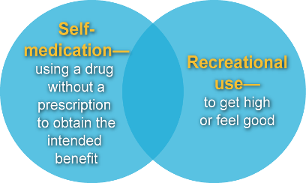
What is Rx drug abuse?
The misuse of Rx drugs is an under-recognized health issue that puts young lives at risk.
Misuse includes:
Rx drugs serve an important purpose when used under a healthcare professional’s supervision.
Misuse can lead to overdose, addiction and death.
Notes:
Many people are unaware that teens are misusing and abusing prescription drugs—the very same medicines that are used legitimately to relieve pain and treat conditions such as anxiety or sleep disorders, depression or ADHD.
The term “misuse” includes self-medication and recreational use of these medicines.
Let’s keep in mind that when taken by the right person, at the right dose, at the right time and in the right way, these medications are valuable. Prescription drugs can help cure certain diseases, relieve symptoms and restore quality of life.
However, the misuse or “nonmedical use” of these drugs is very dangerous and can lead to overdose, addiction and death.

Slide 5
The Problem
  Six percent of 12th graders report using narcotic drugs, among the most dangerous of prescription medications.
  Fourteen percent of 12th graders report using one or more of these prescription drugs: narcotics, sedatives, tranquillizers, and/or amphetamines.
  Three percent of high school students report taking a prescription drug without a prescription.
  Teens today perceive fewer risks associated with misusing or abusing prescription stimulants than did their peers in 2009.
Notes:
While the rate of tobacco, alcohol and illicit drug abuse is down overall, more teens are turning to prescription drugs.
[Refer to the statistics on the slide. Consider asking the group what surprises them most about these numbers.]
These numbers paint a sobering picture. It’s a problem that needs more attention—and it must be consistently addressed at home, in schools, on the field and in doctors’ offices.

Slide 6
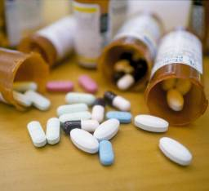
Dangers of Abusing Rx Drugs
Increases in blood pressure or heart rate
Damage to the brain and other organs
Accidental overdose/poisonings
Physical dependence
Addiction
Breathing problems
Seizures
Death
Risks associated with mixing multiple drugs or combining with alcohol
Notes:
Abusing prescription drugs is dangerous.
Teens take these drugs, sometimes mixing them with alcohol and other substances, not knowing what their effects might be. We know some teens will abuse different classes of drugs for their practical effects—one to help them focus or stay up all night to write a term paper or cram for the next exam, another to help take the edge off, and still another to help them fall asleep.

Slide 7
Teens & Rx Drug Abuse
Teens engage in a variety of risk-taking behaviors
  Period of uncertainty and self-discovery
  Experimentation sometimes seen as a rite of passage
  Teen brain is not yet fully developed
  Poor judgment and insight and lack of impulse control
Rx drugs are now part of teen culture
  Popularity of “pharming” and “bowling” parties
Notes:
Any teen is susceptible to engaging in risk-taking behaviors. The teen years are a time of tremendous uncertainty and experimentation. Teenagers find themselves on an unsteady road of self-discovery, constantly comparing themselves to their peers, wanting to be accepted and, at the same time, pushing the limits of their independence. They feel the pressure to do well at, and also are dealing with the angst of puberty, including physical changes and surges in hormones. And because the teen brain is not yet fully developed, teens’ impulse control, judgment and ability to make sound decisions is not as good as they (or you) might think. Unfortunately, prescription drugs are also a noticeable part of teen culture these days. One trend is “pharming” or “bowling” parties.
[Ask the group to raise their hands if they’ve heard of these.]
At these parties, teens will mix different kinds of prescription drugs together in a bowl or a bag (also called making “trail mix”) and will take a handful of pills. They often don’t know what drugs they are taking or how they will affect their mind or body, nor would emergency medical responders in the event that they need to treat a teen and counteract the drug’s effect.

Slide 8
Why Are Teens Abusing Rx Drugs?
They’re easy to get
Thrill seeking
Friends are doing it
Escape problems or self-medicate
Lack of self-esteem
Seen as safer alternative with fewer side effects
Less stigma associated with Rx drugs
Parents less likely to disapprove
Notes:
So, why are teens abusing prescription drugs? We’ve already mentioned some of these, but there are many reasons…
They are easy to get.
To thrill seek—these drugs offer a quick high, especially if they crush or snort certain medications. To escape problems or self-medicate so that they have a better handle on their lives; they will often turn to drugs to reduce stress, get sleep, boost their mood or enhance concentration or performance.
If they lack self-esteem, they may turn to these drugs to take the edge off and be more sociable.
These drugs are perceived to be a safer alternative with fewer side effects than illicit street drugs because they are approved by Food and Drug Administration and prescribed by a healthcare professional
There is less stigma using these than “street drugs.”
They think that parents will be less likely to disapprove of these drugs compared to other substances.

Slide 9
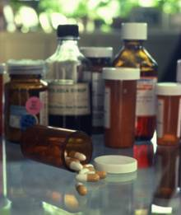

Why Are Teens Abusing Rx Drugs?
They’re looking for help.
Feeling good or getting a “high” is not as big a motivator as with street drugs.
Notes:
Unlike with other forms of adolescent drug use, the desire to feel good or get high ranks much lower as a motivator for prescription drug misuse. More often, teens turn to prescription drugs to help manage their daily lives—for example, to lower stress and anxiety, boost their mood or increase performance.

Slide 10


Other Factors Driving Trend: Accessibility
Rx medicines can be found in homes of family or friends.
Many parents aren’t aware of the dangers.
Many parents do not know how to effectively talk with their children about Rx drug abuse.
Notes:
These medications are appealing to teens because they’re typically easy to get and free. Plus teenagers will see mom, dad or grandma take these drugs and they seem fine, so what’s the harm?
There is also an overall lack of awareness about the problem.
Fewer parents and teens are actively talking about drug and alcohol abuse. AND we know that when parents express strong disapproval of drug use, teens are far less likely to engage in drug-taking behaviors. So parents and other trusted adults must look for teachable moments to talk about the issue.

Slide 11

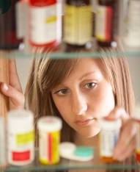
Other Factors Driving Trend: Invincibility
Teens mistakenly believe:
  It’s safer to abuse Rx drugs than illicit drugs, even if they’re not prescribed by a doctor.
  Rx drugs have fewer side effects and are not as addictive.
  It’s okay to share these drugs.
Notes:
Four out of 10 teens incorrectly believe prescription drugs are safer to abuse than street drugs. They also think these drugs have fewer side effects and are not as addictive. They may see no problem sharing medications. The reality is that prescription drugs are only safe to use at the dose they’ve been prescribed for you by a doctor who knows your health history. And it’s illegal to be in possession or distribute controlled substances like strong pain medications called opioids, which many teens are after.

Slide 12

Other Factors Driving Trend: Pill-Taking Society
Rx medications are all around us…and teens notice.
  Patients leave the doctor’s office with a prescription in hand in 7 out of 10 visits.
  Direct-to-consumer advertising on TV and in magazines.
Many people don’t know how to safely use these medications or ignore their doctor’s instructions.
Notes:
Prescription drugs are often a mainstay of treatment for various illnesses including migraine, infections, heart disease, diabetes, depression, arthritis, cancer and many others. TV and print media are also filled with ads for these medications. So teens may come to believe there is a pill for everything. In general, Americans aren’t well informed when it comes to medication safety. Most of us need to be better educated about how to safely use, store and get rid of these medications. We’ll talk about this more later.

Slide 13
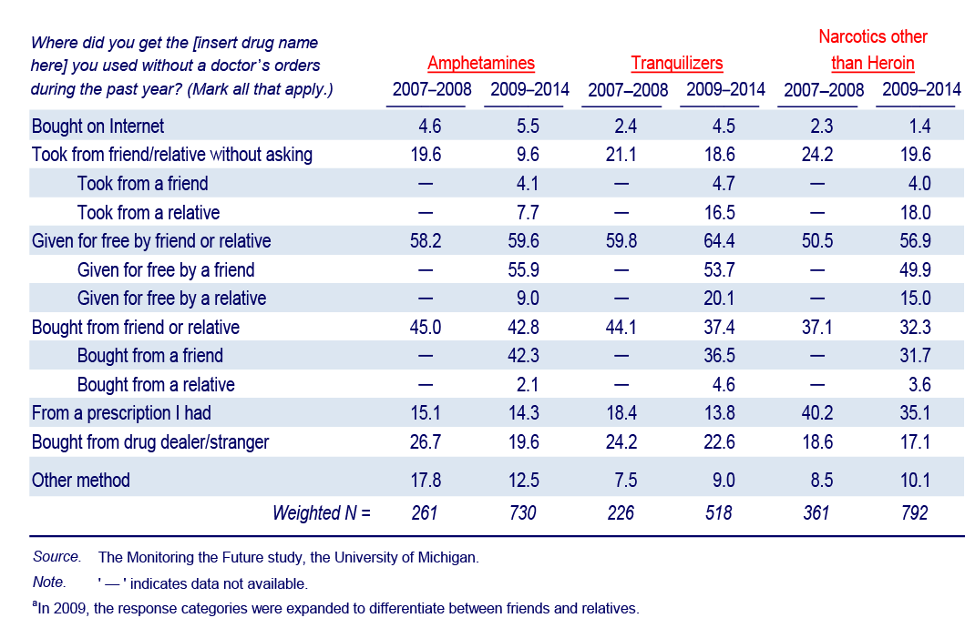
Source of Prescription Drugª
Among Those Who Used in Last Year Grade 12, 2007-2014
(Entries are percentages.)

Slide 14
Teens Rx Drugs of Choice for Abuse
 | How they work | Abused by teens to | Drug names
Strong Pain Relievers | Used to relieve moderate-to-severe pain, these medications block pain signals to the brain | To get high, increase feelings of well being by affecting the brain regions that mediate pleasure | Vicodin, OxyContin, Percocet, Lorcet, Lortab, Actiq, Darvon, codeine, morphine, methadone
Stimulants | Primarily used to treat ADHD type symptoms, these speed up brain activity causing increased alertness, attention, and energy that comes with elevated blood pressure, increased heart rate and breathing | Feel alert, focused and full of energy—perhaps around final exams or to manage coursework, lose weight | Adderall, Dexedrine Ritalin, Concerta
Sedatives or tranquilizers | Used to slow down or “depress” the functions of the brain and central nervous system | Feel calm, reduce stress, sleep | Valium, Xanax, Ativan, Klonopin, Restoril, Ambien, Lunesta, Mebaral, Nembutal, Soma
Notes:
Drugs commonly used by teens include:
Strong pain medications that are prescribed to treat moderate-to-severe pain. Teens often go in search of these to get high. Stimulants, or uppers, speed up brain activity, resulting in greater alertness, attention, and energy. Teens may turn to these to feel alert and be able to pull all-nighters to stay on top of coursework. Stimulants can make the heart beat faster and put the user at risk for stroke or heart attack. Sedatives, or downers, slow down brain activity. The result is a drowsy or calming effect. Other sedatives include tranquilizers and muscle relaxants. Sedatives can reduce heart rate and the body’s response to breathing
Teens also abuse cough medicines and other over-the-counter medicines. They may take any of these with alcohol or other substances.

Slide 15
Physical Warning Signs
  Excessive sweating, urination or thirst
  Nausea and vomiting
  Uncontrollable diarrhea
  Spastic shaking
Drowsiness, dizziness and insomnia
Loss of consciousness
Physical dependence
Addiction
Hospitalization
Notes:
It’s very important to watch for signs of problems.
The physical signs of abuse will be very different depending on the individual and the drug that is abused. The ones listed here are general, but we have created an additional sheet that lists warning signs by drug category-pain medications, stimulants and sedatives/tranquilizers.

Slide 16
Behavioral Warnings Signs
Sudden mood changes, including irritability, negative attitude, personality change.
Extreme changes in groups of friends or hangout locations.
Lying or being deceitful, unaccounted time away from home/missed school days, avoiding eye contact.
Losing interest in personal appearance, extracurricular activities or sports.
Poor performance at school.
Borrowing money or having extra cash.
Visiting and even purchasing from pro-drug abuse (illegal) web sites.
Notes:
There are also behavioral clues…[read from slide or allow audience to read]

Slide 17

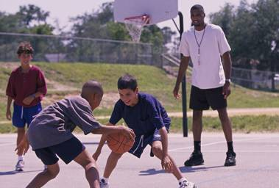
NOW THAT YOU KNOW…
DOING YOUR PART…
Notes:
Now that you know…you can do your part to help curb prescription drug abuse among teens.

Slide 18



Who Can Make a Difference?
Parents
Grandparents, aunts/uncles, other family members
Teachers
Coaches
School administrators
Guidance counselors
School nurses
School resource officers
Community-based healthcare professionals
Notes:
Teen influencers matter. Whether you’re a parent, grandparent, teacher, coach, guidance counselor, school nurse or resource officer, or a community-based health professional, you can make a difference by educating teens and other teen influencers about the risks of prescription drug abuse. There is a saying in public health to “go where the people are”—that’s the only way you can make a measurable difference in prevention and health behavior change. Teen influencers who interact with teens on a regular basis can look for teachable moments to talk to teens about the dangers of prescription drug abuse and to promote healthy alternatives.

Slide 19
Parents, grandparents and others
  Many teens report that their parents have the greatest influence on their drug use attitudes and decisions.
  Kids who continue to learn about the risks of drugs at home are up to 50% less likely to use drugs than those who are not taught about these dangers.
  Parents (and other family members) are in the best position to reduce access to prescription drugs by locking up medicines and properly disposing of expired or unused medicines.
Notes:
Parents have the greatest influence on teens’ drug use attitudes and decisions; teens whose parents talk about the risks of drugs at home are up to 50 percent less likely to use drugs. Grandparents, older siblings and other relatives also play a big role in shaping teen decisions.

Slide 20
Educators: teachers, coaches, guidance counselors, advisors and others
Students spend at least 7 hours/day at school--often more time than they spend with parents.
For many students, school may be the one place they can find a supportive adult to talk to.
Educators or counselors may see behavior changes and intervene before parents do.
Notes:
Teachers, coaches and other educators spend a lot of time with teens and, in some cases, may be their main support system. They are also in a position to see behavior changes like a drop in academic or athletic performance, acting out in class or unexplained absences before parents and can intervene early.

Slide 21
Healthcare providers
Are well positioned to assess emotional and physical development of teenage patients, as well as their adjustment to life changes and stressors.
Can talk to teens about drug-taking behaviors, especially with those who show signs of being at risk for misusing or abusing drugs.
Have the skills and training needed to identify Rx drug abuse and help teens and their parents recognize any problems early on.
Notes:
School and community-based health professionals can keep tabs on teens’ physical and emotional development; they can identify problems and also help combat prescription drug abuse where it might start by educating all patients about the safe use of medicines in the home and, when necessary, in the school.

Slide 22
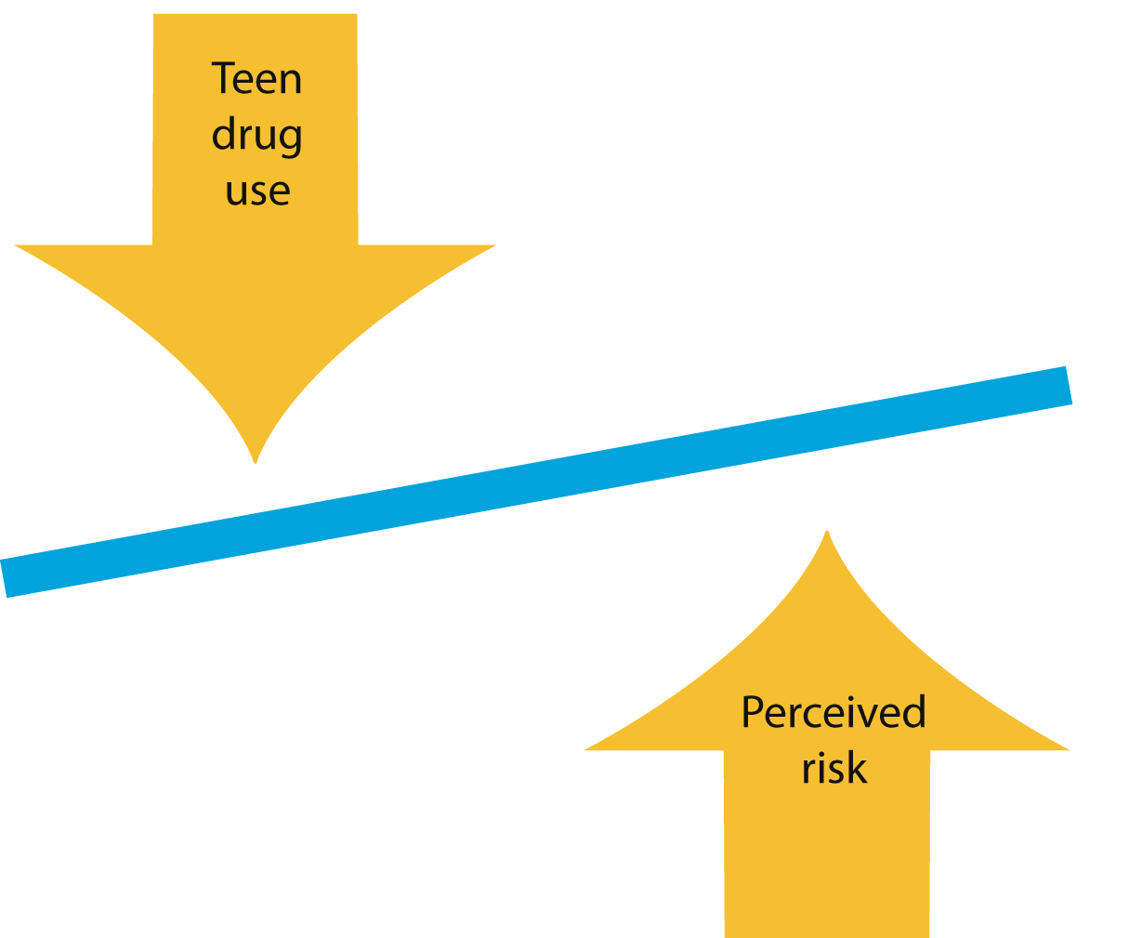
Talking to Teens Works
Notes:
We know talking works. Rates of substance abuse by teens have declined dramatically in the last decade due, in large part, to collective efforts of the anti-drug and prevention communities and communicating the risks. As the perception of risk goes up, teens’ willingness to abuse or a misuse substance goes down. So, talking to them about the true dangers of prescription drug abuse in an ongoing, direct way is critical.

Slide 23
Talking to Teens About Rx Drug Abuse
Brief screening/intervention
A conversation in the hallway, in the car or on the field can make a difference.
Empathize with teens
Validate common stressors facing teens (pressure to excel academically, fit in with peers, find their place in the world).
Provide healthy alternatives for coping (exercise, playing sports, drug-free social activities).
Notes:
Take advantage of opportunities to talk with and listen to teens—even a brief conversation can help steer a teen in the right direction. It’s important to empathize with the pressures and uncertainties they face and offer other options for staying healthy.

Slide 24
Talking to Teens About Rx Drug Abuse
“Denormalize” the behavior
  Most teens are not abusing prescription drugs.
Debunk common myths
  Misuse and abuse of prescription medications is as dangerous as misuse and abuse of other substances and can be as addictive.
  It’s not okay to misuse these drugs, even “once and a while.”
If you are a parent
  Be mindful about how you use and talk about medicines in front of teens.
Notes:
And although teens might think “everyone is doing it,” be sure they know that while one in five teens abuse prescription drugs, four out of five are not.
It’s important to set the record straight about the dangers of prescription drug abuse and present the facts. Inform teens and others that abusing prescription drugs is just as dangerous as abusing street drugs, and it can also be as addictive and deadly. There is no safe way to get “high,” and it’s not okay to rely on these drugs to help manage stress or get “high,” even “every once and a while.” If you are a parent, set clear limits and a good example.

Slide 25
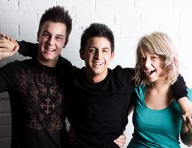
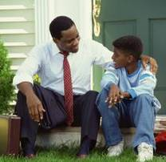
Talking to Teens About Rx Drug Abuse
Give teens an escape route
  Teach them how to get out of a bad situation.
  Suggest a response they can use so they don’t feel “uncool.”
    “I don’t want to ruin my season/get in trouble with the coach.”
    “I have to do something with my parents really early tomorrow morning.”
    “I’m the designated driver.”
    “I’m not interested.”
    “No, thanks.”
Notes:
Talk to them about how to get out of a bad situation. Offer to pick them up wherever they are if they are in trouble. Give them some effective ways to say “no” so they don’t feel “uncool” when talking to their peers. Help role play with them so they gain confidence.

Slide 26
Challenges to Reaching Teens
Rebellious side—they want to experience life and do new things
Peer pressure—they may be swayed by others
Poor judgment—they think they are invincible, “nothing can hurt me”
Competition for their attention—smartphones, social networking sites, pop culture that normalizes drug use, surfing Internet, access to pro-drug abuse information
Notes:
So, we all have the opportunity to reach teens with important prevention messages, but there are some challenges…
They can be rebellious and want to experience life and do new things.
They can be swayed by their peers, and are often bombarded with opportunities to try new things.
They think they are invincible, somehow shielded from any harm.
In this fast-paced information age, there are tons of competing messages (iPod, Internet, social networking sites, pop icons like celebrities who make the news tales of prescription drug abuse), which leave fewer opportunities to talk.
They can do their own research on the Internet.

Slide 27


It’s Your Turn
Notes:
[Ask attendees to divide into pairs or small groups. Give a scenario—a list of scenarios are in the back of the Presenter’s Guide—to each pair and ask that they role play/discuss how best to handle the situation. They can take 10-15 minutes for this activity. Reconvene the group and briefly discuss lessons learned—what they found challenging, etc.]

Slide 28
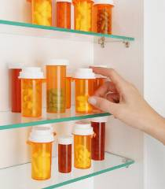
Ways to Help
Teens learn by example
  When they see mom, dad, a sibling or grandparent taking a pill—even if responsibly—it doesn’t seem so bad.
Most people don’t keep track of their medications
  Monitor all medications in the home—prescription and OTC medicines.
  Safely store medicines out of children’s reach and sight. Consider locking them up.
  Get rid of old or unused medicines.
Notes:
Kids—even teens-- learn by example, so when they see mom, dad, a sibling or a grandparent taking a pill, it doesn’t seem so bad. If you take medications in front of young children or teens, explain why and stress the fact that these are powerful medications that are only safe to use by the person for whom the doctor recommended it.
How often do you go through your medicine cabinet to get rid of unused or expired medicines? Do you even know what’s in there? Probably not.
Anyone who has teens living in or possibly visiting their household should take these precautions:
Monitor all prescription and over-the-counter medicines that you and other family members keep in the house, count the pills and check for missing medicine.
Safely store medicines in a dry, cool place (the bathroom medicine cabinet is not an ideal place anyway—it’s warm and damp). Don’t stockpile prescription drugs and keep them in a safe place out of children’s sight and reach. Many people will save medications, especially antibiotics, pain or sleep medications, for themselves or other family members to use in “emergency” situations. Don’t give your medicines to someone else--you never know how the drug will affect them.
Properly dispose of old or unused medications. Most prescriptions drugs can be placed in a non-see-through container mixed with coffee grinds or kitty litter and thrown in the garbage. Be sure to consult your pharmacist or the drug information accompanying your prescription as certain controlled substances should be flushed down the toilet.

Slide 29
Make an Ongoing Difference
Pass it On – give this workshop to other teen influencers.
  Partner with local community and religious organizations.
  Team up with the school's guidance department or resource officer.
  Contact your local PTA to see how you can help. Offer to speak at their next meeting.
Plan a town hall meeting to inform your community about the problem.
Notes:
We must work together to deter prescription drug abuse among teens. Each of you has the ability--at home or in your place of work--to talk to teens and let other influencers know about this problem. So I hope that you will take steps following this workshop to make a difference.
[Refer to handouts for educators, parents and healthcare providers that outline strategies not only for talking to teens, but also to help educate and mobilize other teen influencers and their communities to take steps to help curb teen prescription drug abuse]

Slide 30
Make an Ongoing Difference
Find out whether there are teen-driven initiatives locally.
Lend your voice and time to a local coalition working on these issues.
Enlist a local pediatrician, pharmacist, nurse or other healthcare provider to help deliver message.
Share and tap into existing resources.
Engage your local news media to increase awareness.
Notes:
[Read from slide]

Slide 31
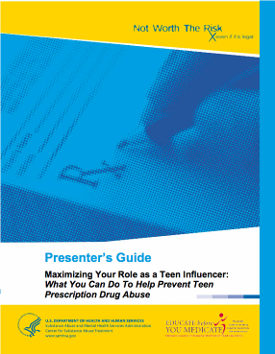
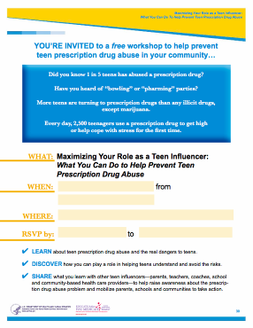
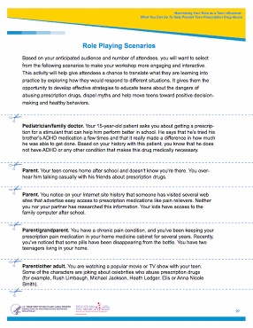
Make an Ongoing Difference
Notes:
We’ve developed a series of handouts for parents, educators and healthcare providers. Each includes practical tips and strategies that you can use to help curb prescription drug abuse among teens at home, school, on the field, in the clinic or at the local pharmacy. A wealth of other resources are provided as well.

Slide 32


Resources
Community Anti-Drug Coalitions of America
www.cadca.org
National Council on Patient Information and Education
www.talkaboutrx.org
National Institute on Drug Abuse
www.nida.nih.gov
Partnership for Drug-Free Kids
www.drugfree.org
Substance Abuse and Mental Health Services Administration
www.samhsa.gov
Team Against Opioid Abuse
TeamAgainstOpioidAbuse.org
Notes:
These and other resources are available for download [and also in the handouts—if you provided photocopies].

Slide 33

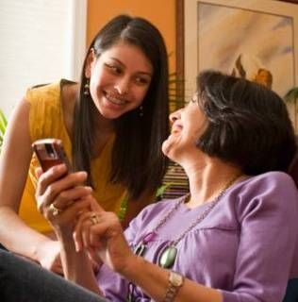
Wrap up & Questions
Notes:
[Review handouts and remind everyone to take a few minutes to complete the evaluation form.]

Slide 34
References
Johnston, L. D., O'Malley, P. M., Miech, R.A.,Bachman, J. G., & Schulenberg, J. E. (2015). Monitoring the Future national results on adolescent drug use: Overview of key findings, 2014. Ann Arbor, Mich.: Institute for Social Research, the University of Michigan.
Hing E, Cherry DK, Woodwell DA. National Ambulatory Medical Care Survey: 2004 Summary. Advance Data from Vital and Health Statistics, No. 374. Hyattsville, MD: National Center for Health Statistics; June 23, 2006.
National Center on Addiction and Substance Abuse. (2002). National Survey of American Attitudes on Substance Abuse VII: Teens, Parents and Siblings. New York: Author.
Office on National Drug Control Policy, “Prescription for Danger: A report on the troubling trend of prescription and over-the-counter drug abuse among the nation’s teens,” January 2008.

Slide 35
References
Partnership for a Drug Free America. Partnership Attitude Tracking Survey (PATS) 2006 and 2007.
Partnership for a Drug Free America. Not in My House
Substance Abuse and Mental Health Services Administration (SAMHSA), National Household Survey on Drug Use and Health, 2006 and 2008.
SAMHSA “Monitoring the Future,” 2008.
Twombly EC, Holtz KD. (2008). “Teens and the Misuse of Prescription Drugs: Evidence-Based Recommendations to Curb a Growing Societal Problem.” Journal of Primary Prevention, 29(6):503-516.

Slide 36
THIS PROGRAM IS MADE POSSIBLE, IN PART, BY
EDUCATIONAL GRANTS FROM PURDUE PHARMA L.P., AND THE
NATIONAL ASSOCIATION OF CHAIN DRUG STORES FOUNDATION.
THANK YOU
FOR COMING!

